Slide 1
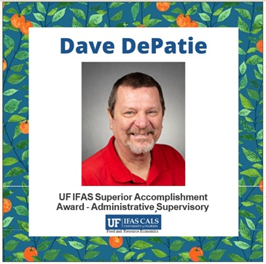
2026 Resume

Slide 2
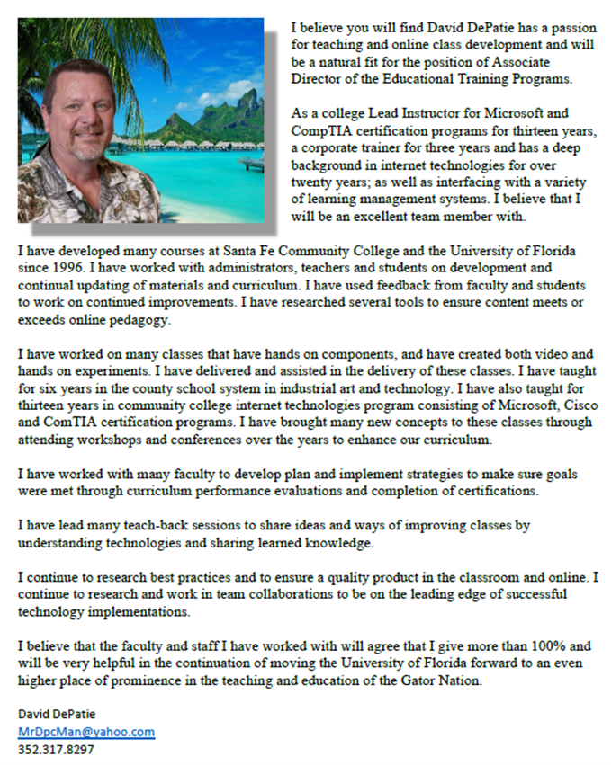
Application for Director of Educational Training Programs

Slide 3
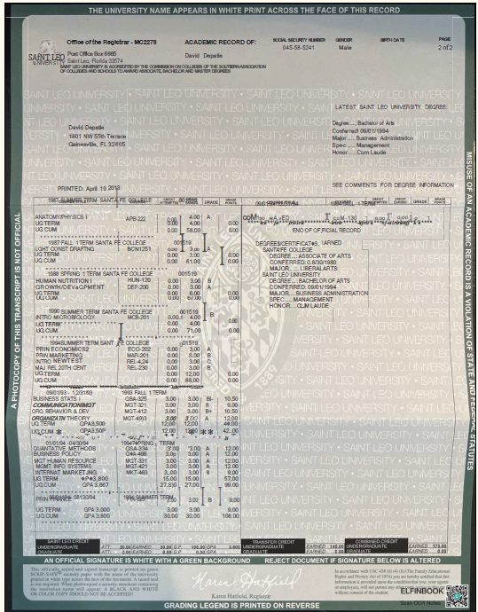
Graduated from Saint Leo College
CUM LAUDE
Bachelor in Business Administration
9/1/994

Slide 4
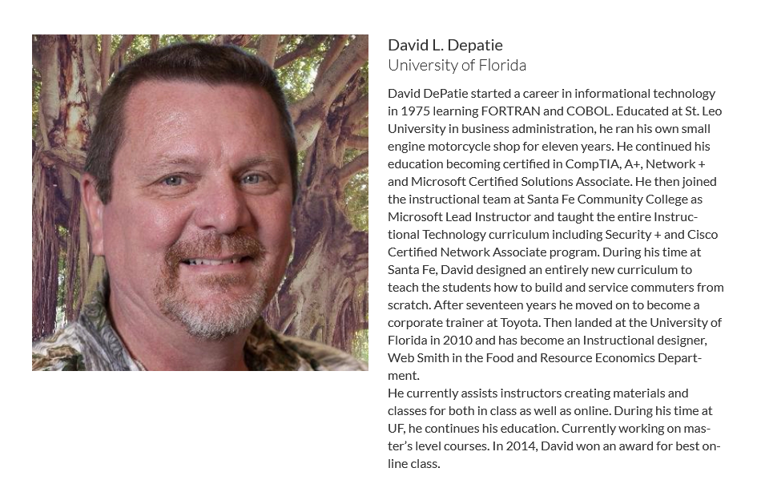

Slide 5
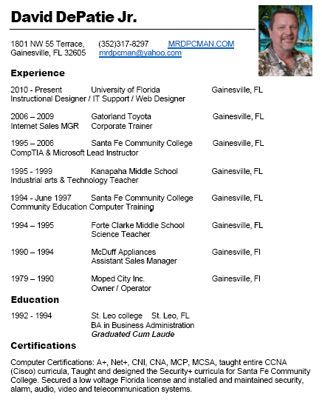
Just a few of my many Experiences

Slide 6
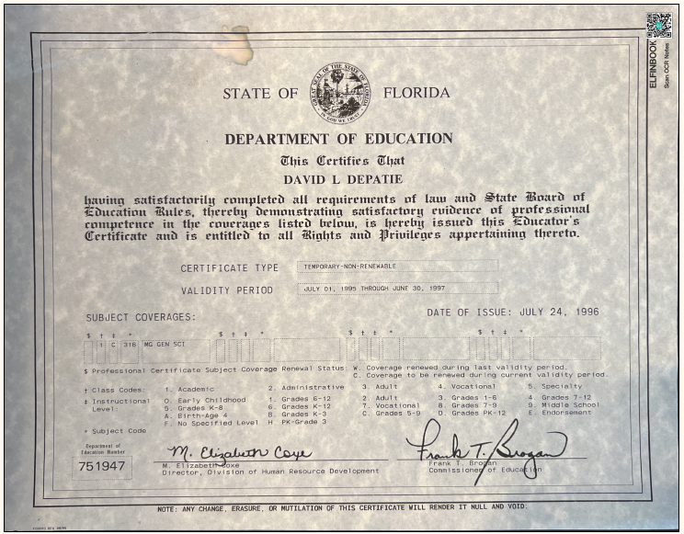
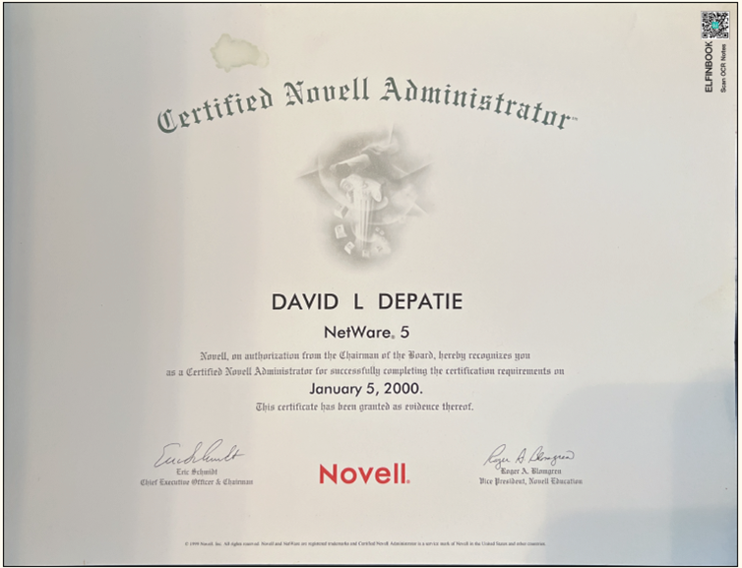
Certifications

Slide 7
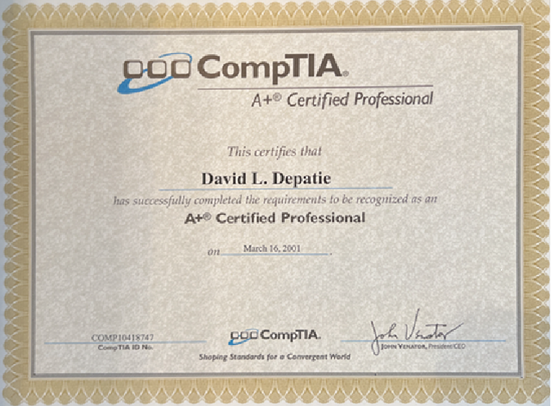
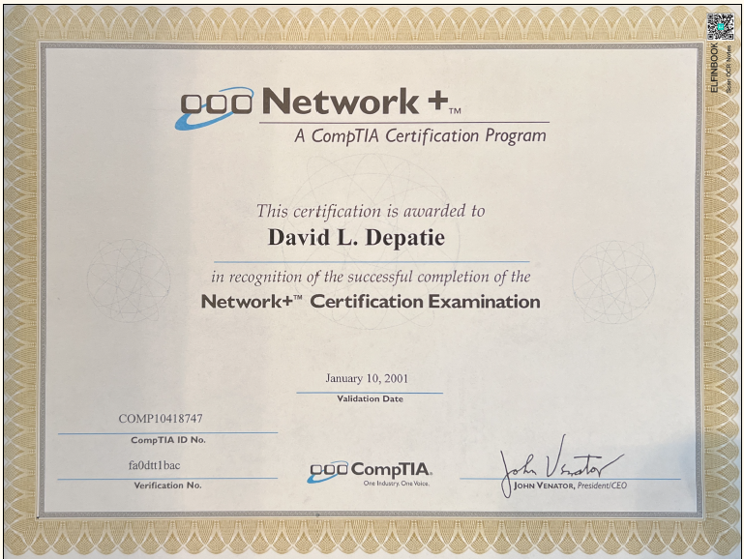
Certifications

Slide 8
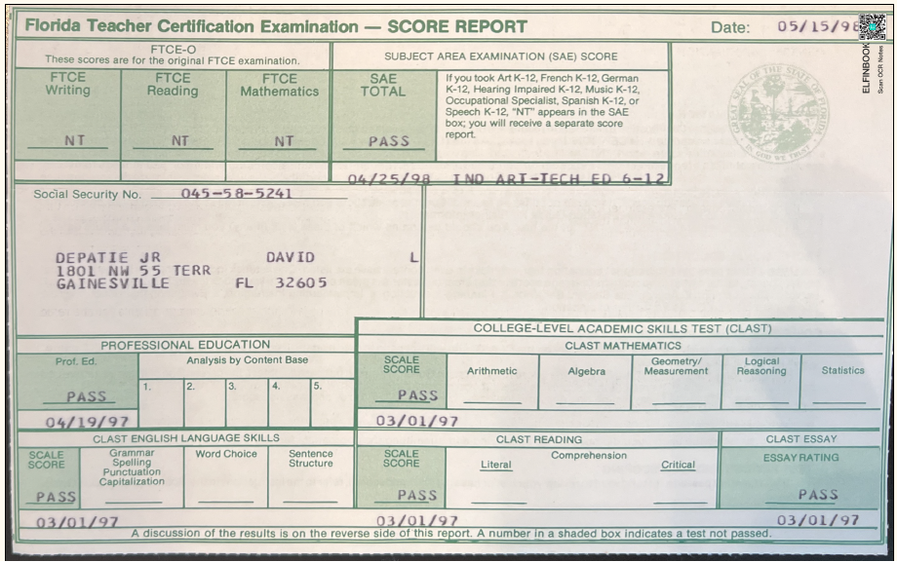
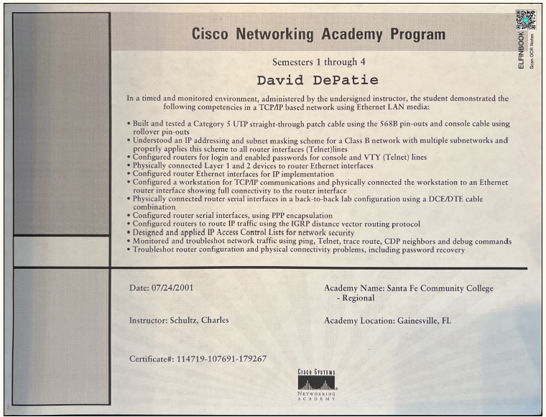
Certifications

Slide 9
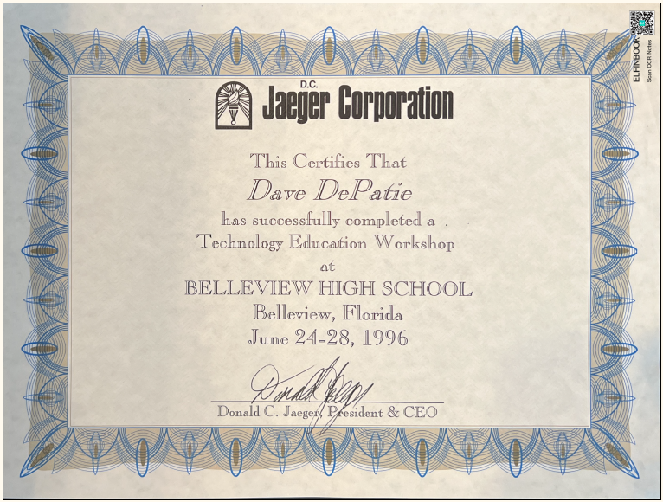
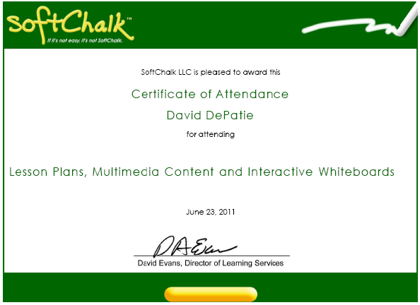
Certifications

Slide 10

Certifications

Slide 11
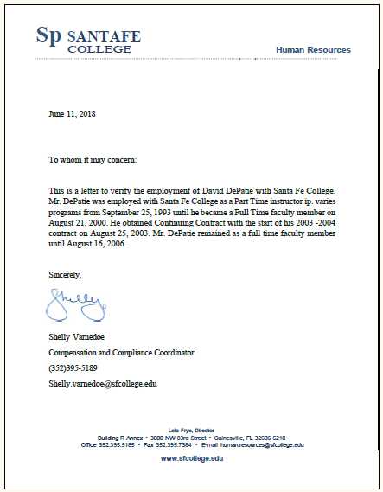
Employment at Santa Fe Community College
09/25/1993

Slide 12
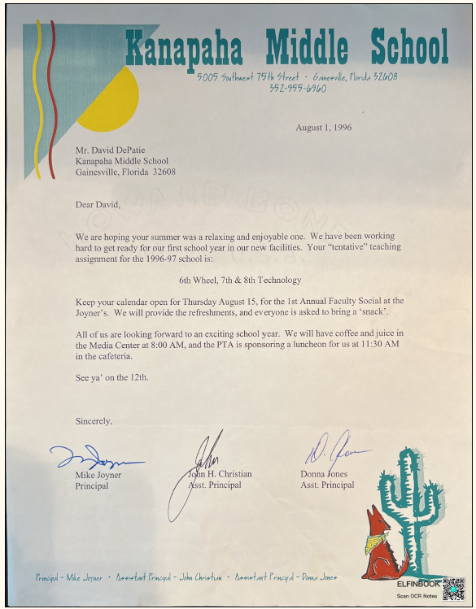
First Year Teaching Middle School
Industrial Arts Technology In New Facility
8/9/1996

Slide 13
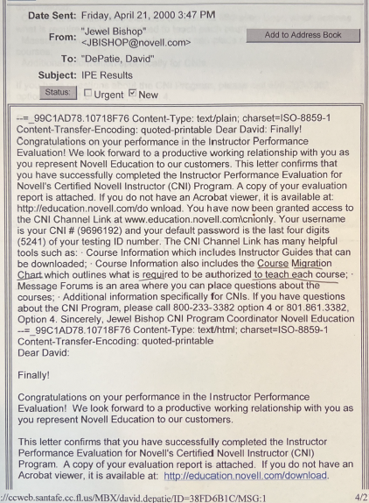
Congratulations from Novell on Instructor Performance Evaluation

Slide 14
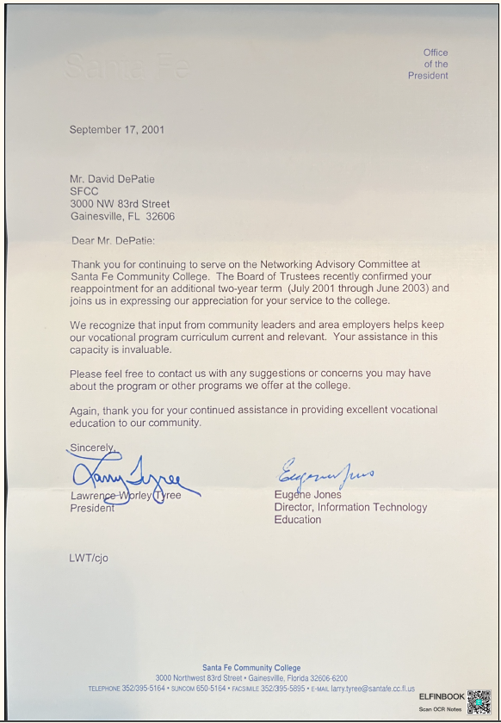
Thank You From The President of
Santa Fe Community
College

Slide 15
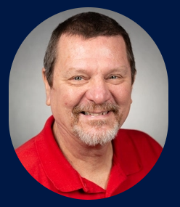
Thank you for taking the time to consider
David DePatie’s
2026 Resume.

